Slide 1
Tri-Robot Cooperation
Milestone 2 Presentation
Nov 21, 2019
Zhaoyang Chen, Jieming Fan,
Bingjie Zhu, Manqin Zhong
EECS 149, Fall 2019

Slide 2
Content
Project scope & goal
Architecture
Progress so far
Demo

Slide 3

Project goal & scope
Scope
Finite State Machine
Networking (BLE techniques)
Sensors and Actuators (UWB transceiver)

Slide 4
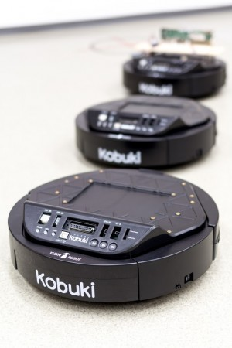
Project goal & scope
Goal
3-Robot system (1 Leader ＋ 2 Followers)
Build a coordinate system via UWB
Task Performance
Random → Triangle → Follow other commands

Slide 5
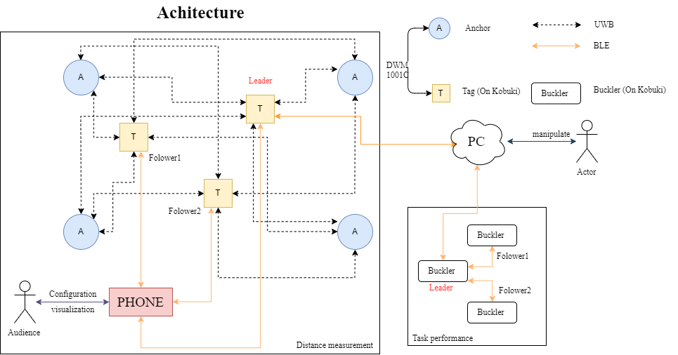
Architecture

Slide 6
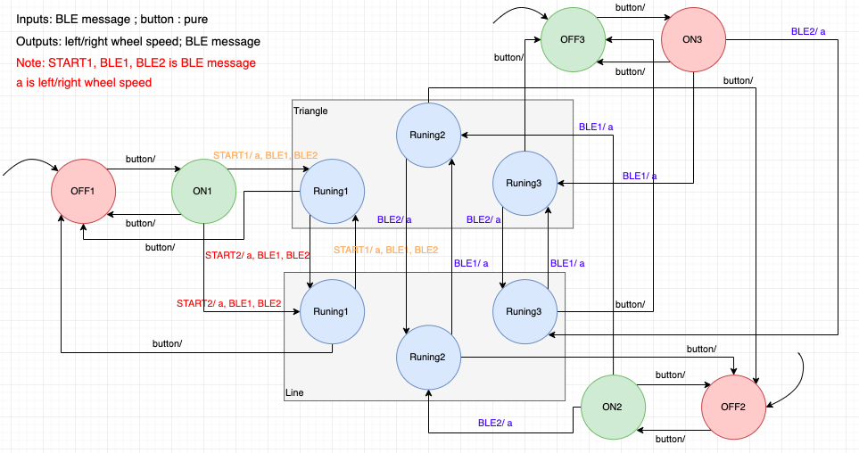
State Machine

Slide 7
Progress so far
BLE communication
Between PC and leader Kobuki
Between leader Kobuki and the follower

Slide 8
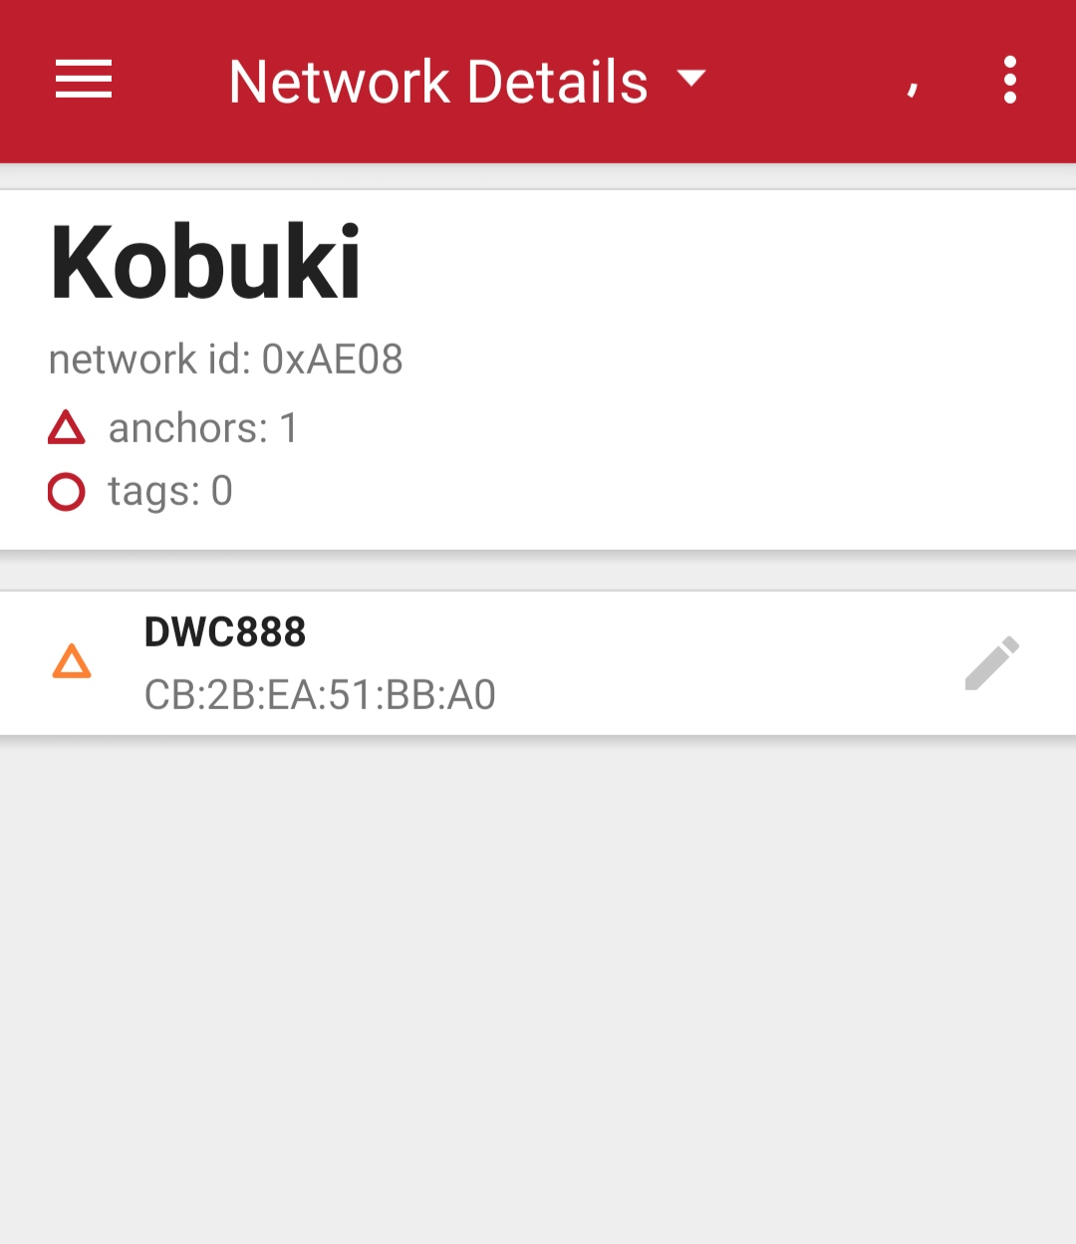
Progress so far
UWB Module
Network construction
Position the anchors
Device test

Slide 9
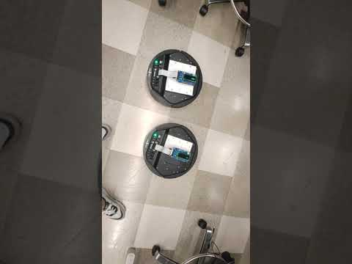
Demo

